Slide 1

Literary Criticism
(BA-TY)
Dr. Nirmala S. Padmavat
Director, IQAC
Nutan Mahavidyalaya, Selu

Slide 2
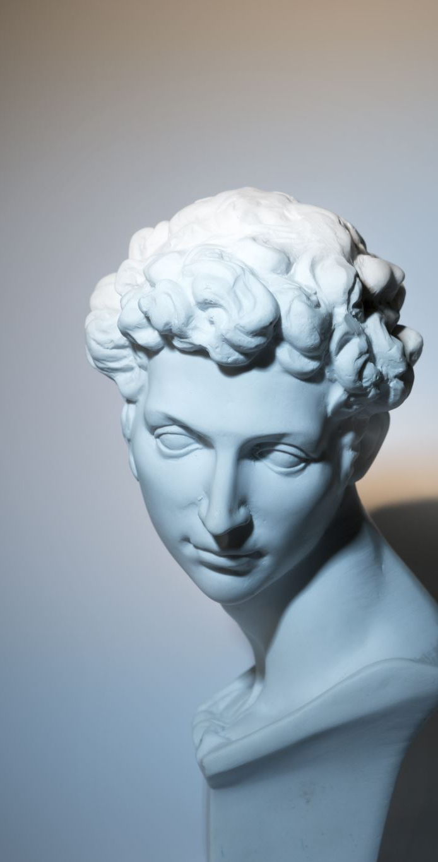
PLATO- Early Life
Plato, the ancient Greek philosopher, was born around 427 or 428 BCE in Athens, Greece. He came from a prominent and aristocratic family, with his father, Ariston, being a descendant of the early kings of Athens, and his mother, Perictione, having connections to the powerful politician Solon. Plato's original name was Aristocles, but he earned the nickname "Plato," which means "broad" or "wide," likely due to his broad shoulders or forehead. He received a well-rounded education, including training in music, gymnastics, and the arts. However, his philosophical journey began when he met the philosopher Socrates as a young man.
Association with Socrates:
Socrates, a philosopher renowned for his method of questioning and seeking truth through dialogue, became Plato's mentor and deeply influenced his philosophical thinking.
Plato became a devoted follower of Socrates and participated in philosophical discussions with him and other members of the intellectual circles in Athens.

Slide 3

Plato’s Literary Work
Plato is best known for his extensive literary output in the form of dialogues. His writings primarily take the form of conversations or debates between Socrates and various other characters, covering a wide range of philosophical topics.
The dialogues are not strictly historical accounts but rather philosophical works exploring different ideas and arguments.
Plato's dialogues are characterized by the Socratic method, where Socrates leads his interlocutors through a series of questions and answers to illuminate the truth and expose flawed reasoning.

Slide 4

Plato’s Notable Dialogues:
"Apology": A defense of Socrates during his trial in 399 BCE, where Socrates defends his philosophical activities and beliefs in the face of charges of corrupting the youth and impiety.
"Symposium": A dialogue exploring the nature of love and the concept of beauty through speeches given by various guests at a banquet.
"Phaedo": A dialogue recounting the final hours of Socrates' life, discussing his thoughts on the immortality of the soul.
"Republic": One of Plato's most influential works, where he presents an ideal state governed by philosopher-kings and explores concepts of justice, education, and the nature of reality.
"Phaedrus," "Meno," "Timaeus," and "Parmenides" are among Plato's other significant dialogues.

Slide 5
Plato’s Views on Criticism
Critique of Poetry: In "The Republic," Plato famously critiqued the role of poets and poetry in the ideal state. He argued that poetry, especially tragic poetry and epic, can have a negative influence on individuals and society. Plato believed that poetry appeals to the emotions rather than reason, leading to irrational behavior and unhealthy emotional responses.

Slide 6

Plato’s Views on Criticism
Mimesis and the Theory of Forms: Plato's dialogues explore the concept of mimesis, which refers to the imitation or representation of reality in art and literature. He was critical of art that merely imitated appearances without access to higher truths. According to Plato's theory of forms, the physical world is an imperfect reflection of a higher realm of abstract, ideal forms. Poetry and art, in his view, can only offer a distorted and inferior copy of these ideal forms.

Slide 7

Plato’s Views on Criticism
Educational Role of Literature: Plato recognized that literature and storytelling had a powerful educational impact on young minds. He emphasized the importance of censoring literature to ensure that it conveyed the right moral and political messages. In "The Republic," Plato proposes that the state should control the content of poetry and allow only those that promote virtues and the state's values.

Slide 8

Plato’s Views on Criticism
Allegory and Symbolism: Plato often used allegory and symbolism in his dialogues to convey complex philosophical ideas. His dialogues, such as "The Cave" allegory in "The Republic," use symbolic storytelling to illustrate profound philosophical concepts and encourage the reader to think critically about reality.

Slide 9

Plato’s Views on Criticism
Ideal Literature and the Philosopher-King: Plato considered literature to have a role in the education and moral development of future rulers or philosopher-kings. He believed that the ideal state should be led by philosopher-kings who possess both philosophical wisdom and moral virtue, as depicted in "The Republic."

Slide 10

Plato’s Views on Criticism
Critique of Imitative Poetry: Plato's most significant criticism of literature centered on the concept of mimesis, or imitation. He was critical of poetry and art that merely imitated the physical world without offering access to higher truths. Plato believed that such imitative art could lead people away from the realm of ideal forms and encourage irrationality and unhealthy emotional responses.

Slide 11

Plato’s Views on Criticism
The Role of Reason over Emotion: Plato valued reason and intellect over emotions. He criticized certain forms of poetry, particularly tragic and epic poetry, for appealing to the emotions rather than promoting rational thinking and philosophical inquiry. Plato believed that literature and art should elevate the mind and encourage the pursuit of truth through reason.

Slide 12
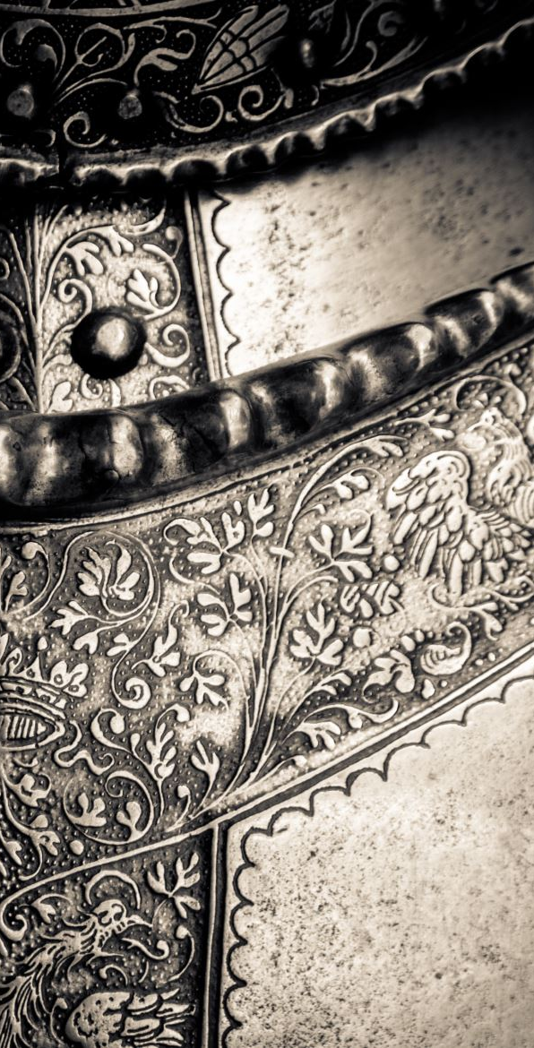
Plato’s Views on Criticism
Censorship of Poetry and Art: In "The Republic," Plato proposes that the state should censor literature and art to control the content and ensure that it conveys the right moral and political messages. He argued for the exclusion of certain types of poetry, particularly those that portrayed gods and heroes as acting immorally, as he believed that such portrayals could negatively influence the moral character of the citizens.

Slide 13

Conclusion
To conclude, Plato's views on literature reflect a complex relationship between admiration and criticism. While he recognized the educational potential of literature, he was critical of certain forms of poetry and storytelling that he believed could have negative effects on individuals and society. His emphasis on reason, morality, and the pursuit of truth influenced his approach towards literature and its role in shaping the ideal state and individual character.

Slide 14

Thank you!

